Slide 1

DATE
Tristan
Citizenship 9

Slide 2
TABLE OF CONTENTS
TABLE OF CONTENTS
WHERE
1
2
3
4
Personal
Community
Global
Aspirational

Slide 3
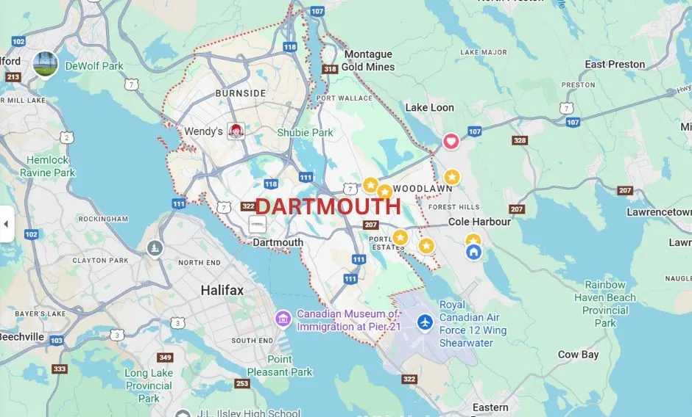
The Personal Place
Cit 9 WHERE
MAP SCREENSHOT (from Bing Maps) | Reflection: Write about a personal place that holds significance for you. Tell the story of the place! My home Guiding Questions: In a second section, describe how your personal perspective shapes the way you see and feel about this place. What stories or memories are tied to this specific location? My home because i live and I was there when i was a kid so that is why i like it. | IMAGE Can’t find a image’s
Notes:
The Personal Place
Reflection: Write a paragraph about a personal place that holds significance for you.
Guiding Questions:: In a second section, describe how your personal perspective shapes the way you see and feel about this place. What stories or memories are tied to this specific location?

Slide 4
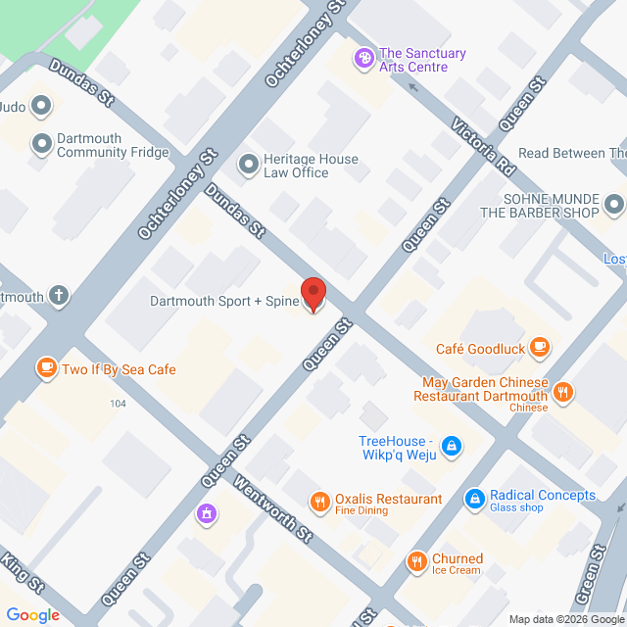
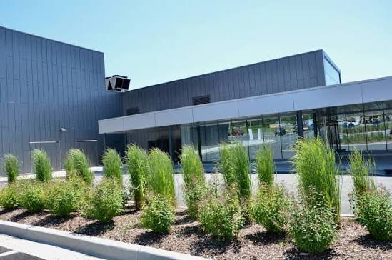
The Community Place
Cit 9 WHERE
MAP SCREENSHOT | Reflection: Write about a significant place in our local community. Tell the story of the place! Who owns it? Why do you like it? Describe something that happened there that you remember. Sportsplex because i like to swim there because it is fun their. And they have a gym to work out and a basketball court to play basketball a running track to run or walk around it and hokey ring. | IMAGE
Notes:
Reflection: Write about a significant place in our local community. Tell the story of the place! Who owns it? Why do you like it? Describe something that happened there that you remember.

Slide 5
The Global Place
Cit 9 WHERE
MAP SCREENSHOT can’t | Reflection: Write a story about a place in the world that is part of your family's story. I don’t have a family story about a place in the world. Guiding Questions: Tell the story of how you and/or your family are connected to this place. What traditions or values from this place have been passed down to you? How does this connect to your cultural identity, including things you do and who you are? Don’t know | IMAGE can’t
Notes:
Reflection: Write a story about a place in the world that is part of your family's story.
Guiding Questions: Tell the story of how you and/or your family are connected to this place.
What traditions or values from this place have been passed down to you?
How does this connect to your cultural identity, including things you do and who you are?

Slide 6
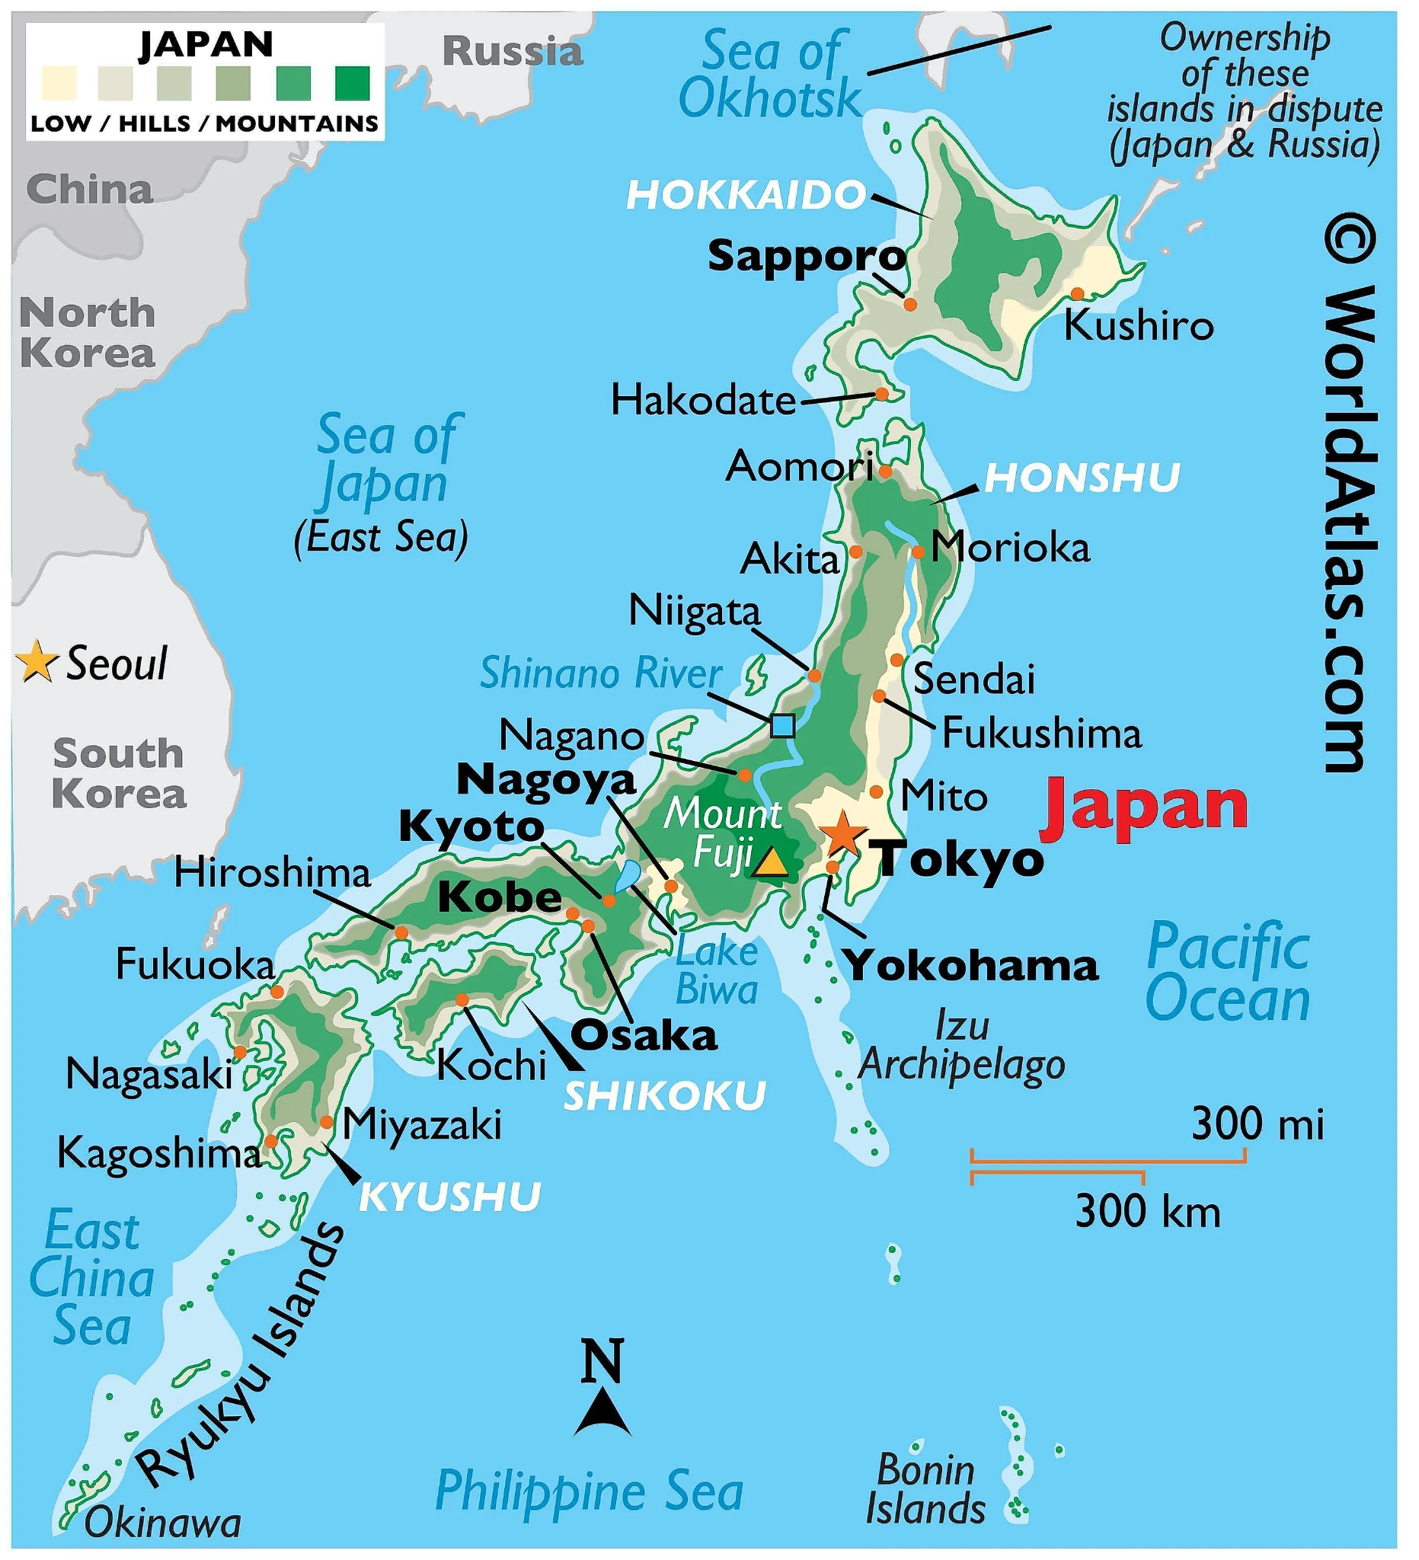
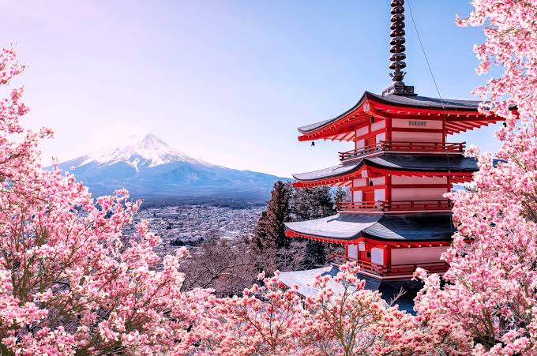
The Aspirational Place
Cit 9 WHERE
MAP SCREENSHOT | Reflection: Write a story about a place you have never been to but dream of visiting. I never been to japan so i want to go there because it looks nice in image’s and they have good stuff there like food catcher and the kimonos that they have there Guiding Questions: What draws you to this place? What do you hope to learn or experience there? How does this place fit into your hopes for the future? The catcher and the food and that is looks nice and i want to visit there and to learn about the stuff there like the storys and i like there trees that they have and the mountain | IMAGE
Notes:
Reflection: Write a story about a place in the world that is part of your family's story.
Guiding Questions: What draws you to this place? What do you hope to learn or experience there? How does this place fit into your hopes for the future?

Slide 7
The Aspirational Place
Cit 9 WHERE
Soundtrack of your life Golden Brown | Post the youtube link here https://www.youtube.com/watch?v=7KIHvuMl4Kk | What’s the story on the song? Write here! "Golden Brown" is a 1981 hit song by the English rock band The Stranglers that features a famous double meaning about a Mediterranean girlfriend and an addiction to heroin
Notes:
Reflection: Write a story about a place in the world that is part of your family's story.
Guiding Questions: What draws you to this place? What do you hope to learn or experience there? How does this place fit into your hopes for the future?

Slide 8
THANK YOU

